Slide 1

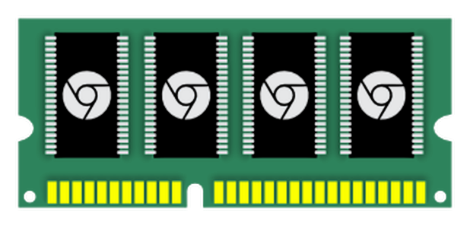
Chrome Memory Infra
bit.ly/memory-infra
BlinkON 2015
petrcermak, primiano & Chrome Memory-Infra team

Slide 2
Agenda
Background Problems
Why are we here today?
Core Technology
How does it work? How can I use it?
Hands On
Demos from real traces. ChromePerf dashboard.

Slide 3
Background
Problems

Slide 4
Background
Problems
Facts

Slide 5


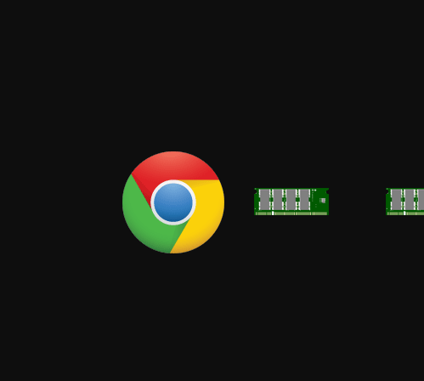

Slide 6
Background
Problems
Complexity

Slide 7
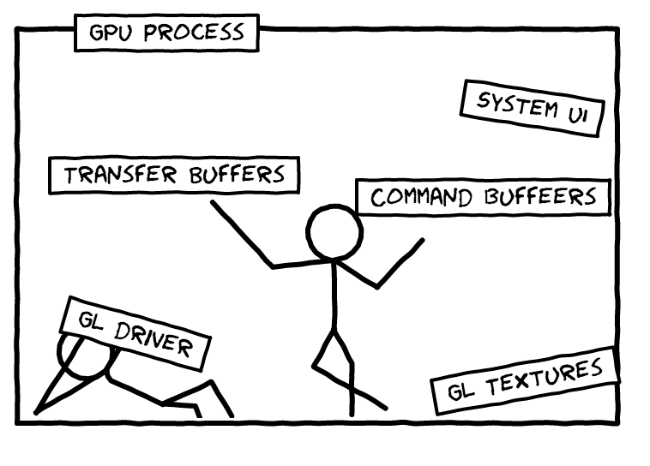
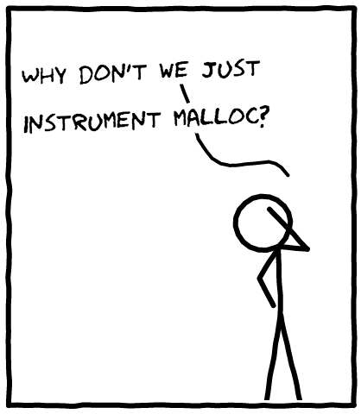
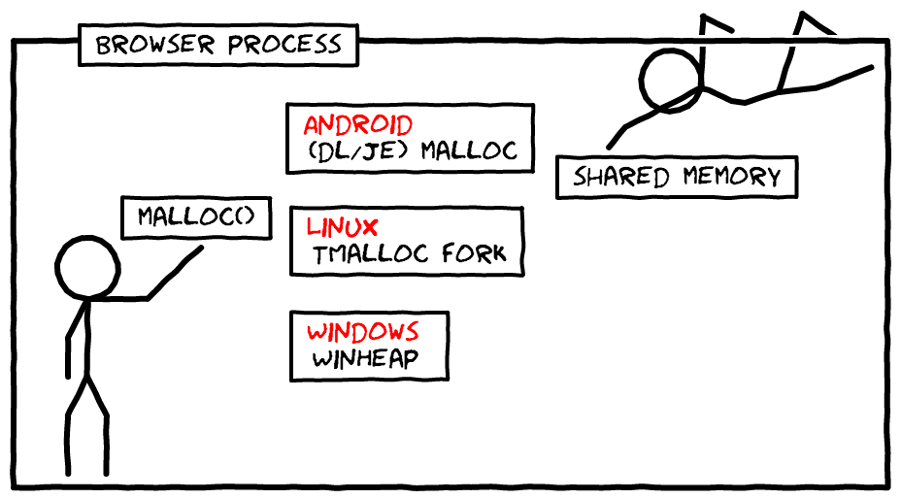
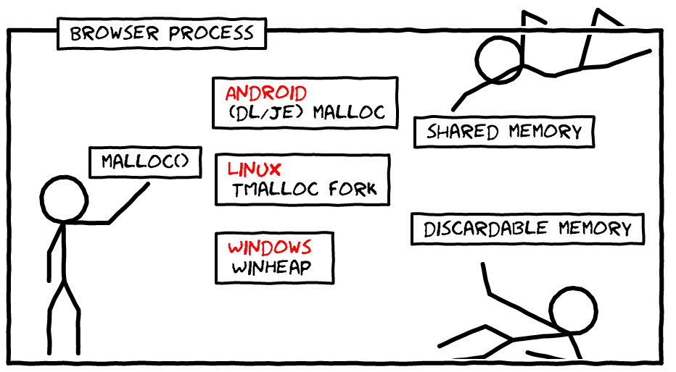
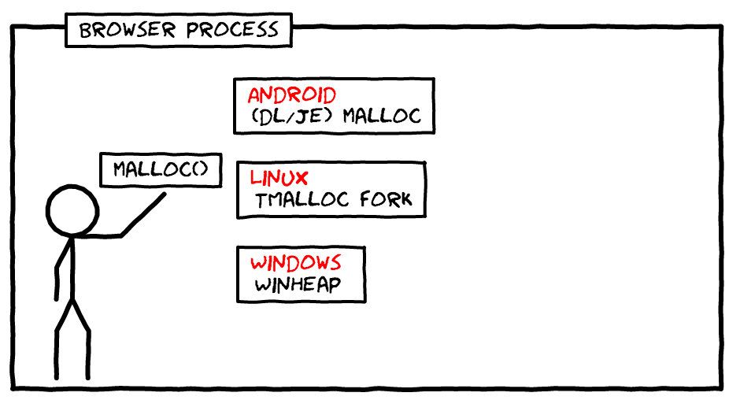

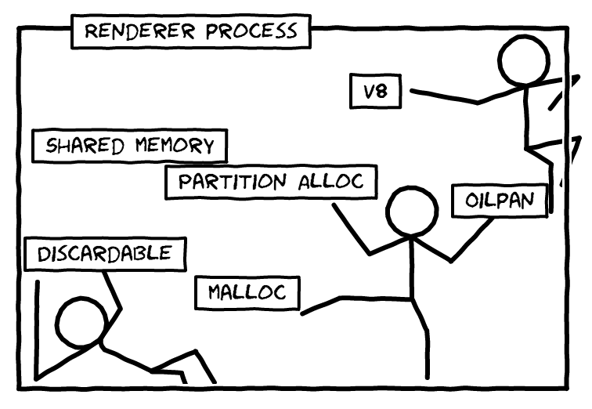

Slide 8
Background
Problems
Working at scale

Slide 9
~200 commits
per day
(only in the main project, post merge)

Slide 10
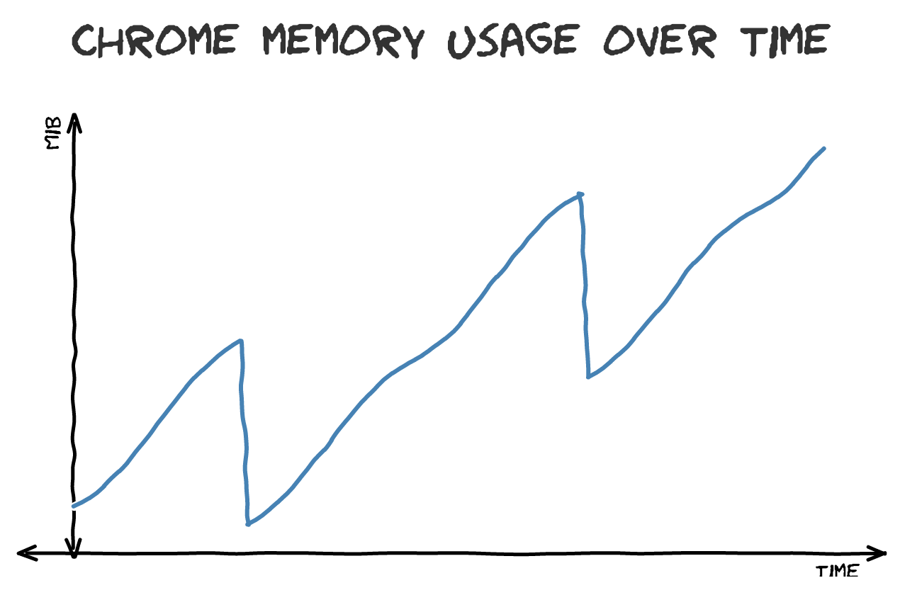
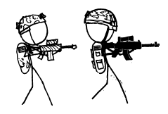


Slide 11


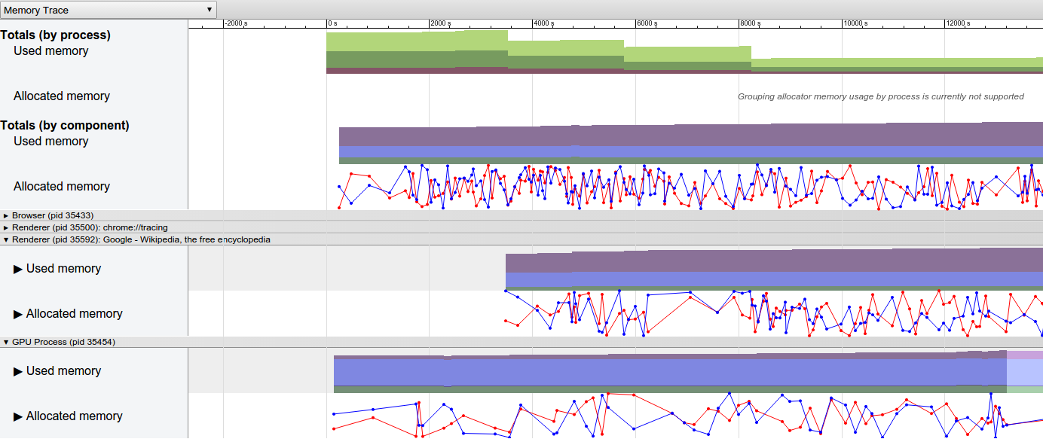
chrome://tracing for full performance lifecycle
So far, plethora of bespoke tools
Specialized / limited scope
Few people use them to fight a fire
People move on -> tool gets unmaintained
Need Chrome-scale tools
Work out of the box
Survives when the fire is over
Integrated with ChromePerf C.I.
memory-infra is part of chrome://tracing
Overview -> spot problems -> route to owners
Reproduce -> investigate -> fix

Slide 12






Use Cases
Chrome /
WebView app
Chrome engineers
Telemetry / C.I.
Partners / web developers

Slide 13
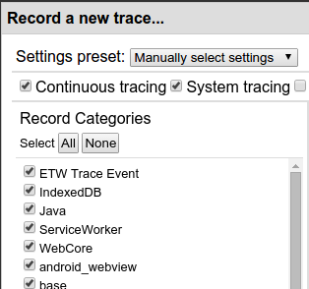
Use Case 1: Local Development / Debugging
chrome://tracing
(chrome://inspect?tracing for Android)
Demos in the last part of the presentation!
Notes:
big picture -> details

Slide 14
Use Case 2: Outreach
12GB!!😾%&*# 💀
chrome://tracing
Can you plz grab a trace?
trace.json
chrome://tracing LOAD
42 extensions !!😾%&*# 💀👿*# 💀😾*# 💀

Slide 15

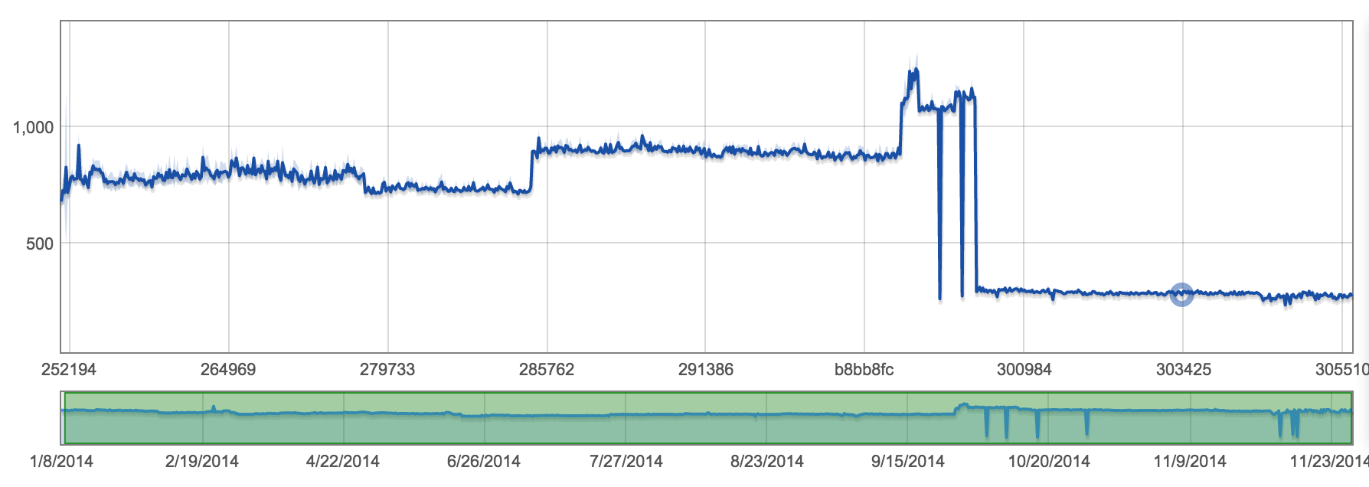
Use Case 3: Telemetry & ChromePerf Dashboard
build.chromium.org
perf waterfall
chromeperf.appspot.com
Benchmark results
perf alert
Full trace
chromeperf.appspot.com
download trace
chrome://tracing LOAD

Slide 16
Core
Technology

Slide 17
chrome://tracing in a Nutshell
::views (/src/ui/views)
::media (/src/media)
::blink (/src/third_party/WebKit)
TRACE_EVENT0(
"views",
"Widget::Init");
TRACE_EVENT0(
"audio", "AudioController::DoPlay");
TRACE_EVENT0( "blink", "Resource::appendData");
TraceLog
Trace
Event
Trace
Event
Trace
Event
{"traceEvents": [
{"cat":"views", "name":"Widget::Init","ts":172, ...},
{"cat":"audio","name":"AudioController::DoPlay","ts":181 ...},
{"cat":"blink","name":"Resource::appendData","ts":192 ...},
]}
trace.json

Slide 18
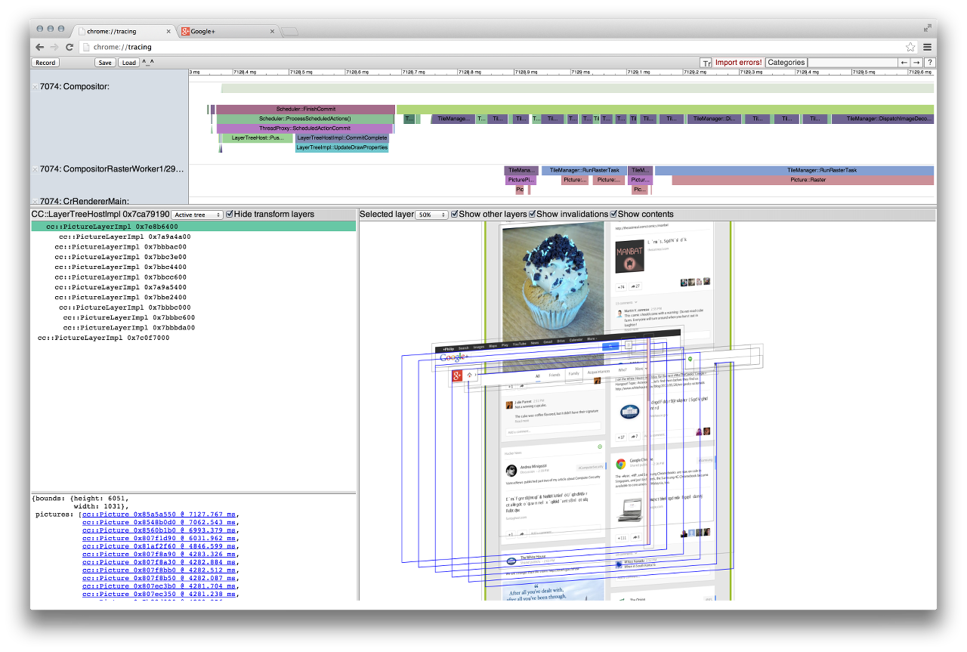
Memory: a New Dimension of chrome://tracing

Slide 19
Architecture of Memory Profiling in chrome://tracing
Memory Dump Manager
System stats
Memory Dump Provider
Memory Dump Provider
Memory Dump Provider
Chrome internals
V8 Isolates stats
Memory Totals
Partition Alloc stats
Process Memory Dump
A snapshot with lot of memory stuff
VM Regions
Compositor stats
...more...
TraceLog
Trace
Event
Trace
Event
Trace
Event
Trace
Event
Notes:
Animations FTW!

Slide 20
Current Support
Supported platforms
Linux, Android, Windows, Mac OSX, CrOS
What is available today
system stats (PSS/RSS/mem maps)
malloc
partition alloc (stats + heap profiling)
oilpan
v8 heap spaces stats
discardable memory
skia caches
web cache
compositor
gpu buffers

Slide 21
Runtime: Multi-process Dump Model
Browser Proc
Renderer Proc
Renderer Proc 2
GPU Process
Dump
Dump
Dump
PMD
PMD
PMD
PMD
ACK
ACK
ACK
trace.json
DUMP
Browser
DUMP
Rend 1
DUMP
Rend 2
DUMP
GPU
= Global memory dump request
PMD
= ProcessMemoryDump
Notes:
Chrome is a multiprocess app. We need consistent snapshots of all of them
(Animations)

Slide 22
Runtime: Threading Model
Browser Process
Renderer Process 1
Renderer Process N
Thread 1
Thread 2
Thread 3
Thread 1
Thread 2
Thread 1
Thread 2
Mem Dump Provider 1
Mem Dump Provider 2
Mem Dump Provider 4
v8 Dump Provider
Oilpan Dump Provider
v8 Dump Provider
Oilpan Dump Provider
Mem Dump Provider 3
Memory Dump Manager
Memory Dump Manager
Memory Dump Manager
TraceLog
Trace
Event
IPC
TraceLog
Trace
Event
IPC
TraceLog
Trace
Event
trace.json
Trace
Event
Trace
Event
Trace
Event

Slide 23
Data Model in Short
Each subsystem reports a tree
Subsystems can cross-reference
Size
Effective size
Size
PartitionAlloc
10 MiB
9 MiB
3 MiB
WebCache
buffer partition
5 MiB
4 MiB
1 MiB
cached scripts
layout partition
3 MiB
3 MiB
2 MiB
cached images
node partition
2 MiB
2 MiB
Edges between subsystems
and “effective size”
create a “responsibility map”
of memory usage
skia caches
4 MiB
2 MiB
glyph cache
1 MiB
1 MiB
resource cache
3 MiB
1 MiB
Notes:
See design docs:
https://docs.google.com/document/d/1GvzDP-tTLmJ0myRhUAfTYWs3ZUFilUICg8psNHyccwQ/edit
https://docs.google.com/document/d/1lep61tPukPOGtZkjMWO_5dmWP7Zvh6ZUhdy84nFY0MQ/edit

Slide 24
Hands On!

Slide 25
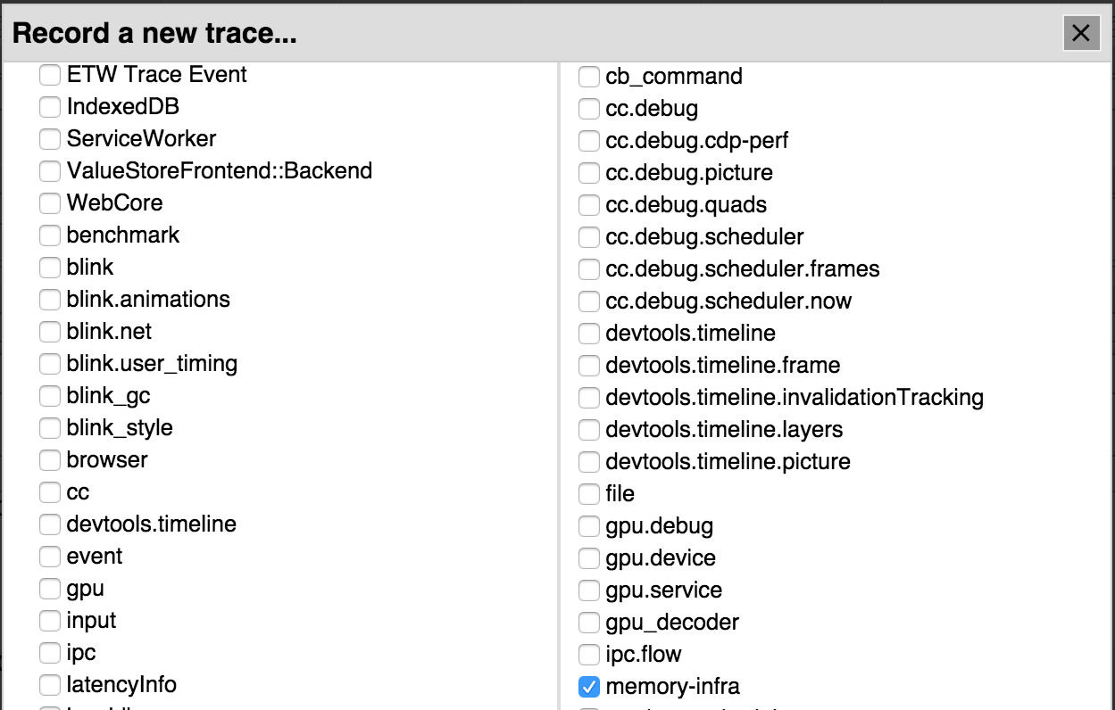
Start a Trace
How to grab a memory trace?
UI: chrome://tracing
Command line: startup tracing
Bots: telemetry benchmarks (coming soon)
Full instructions on the wiki bit.ly/memory-infra

Slide 26
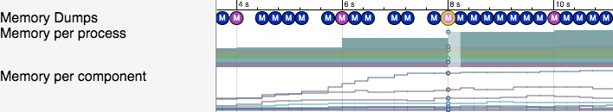


Light vs. Full Dumps
Each dump (M) → snapshot of all Chrome processes
Full dump (default: every 2 s)
Full details about all subsystems
Light dump (default: every 250 ms)
Same totals, same subsystems, but less granularity of their details
Trade-off between level of detail and size of the trace / run-time intrusiveness

Slide 27
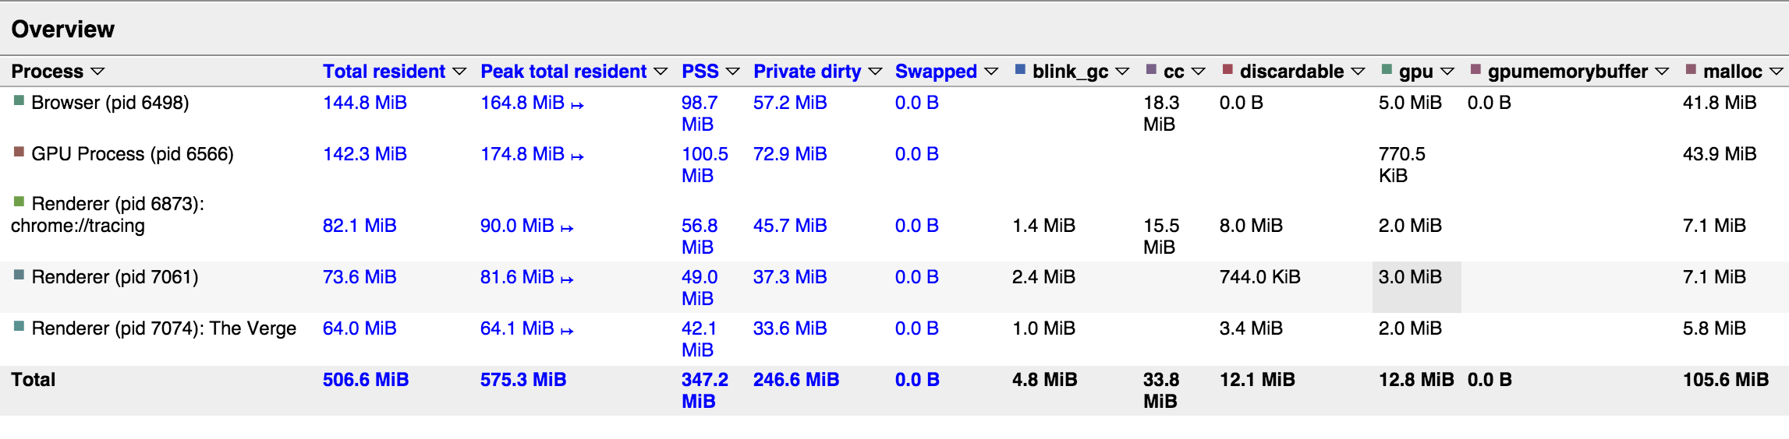
Overview Table of Memory Dump(s)
Blue columns: System stats (Process totals & memory maps)
Black columns: Chrome subsystems (Blink, GPU, V8, …)

Slide 28
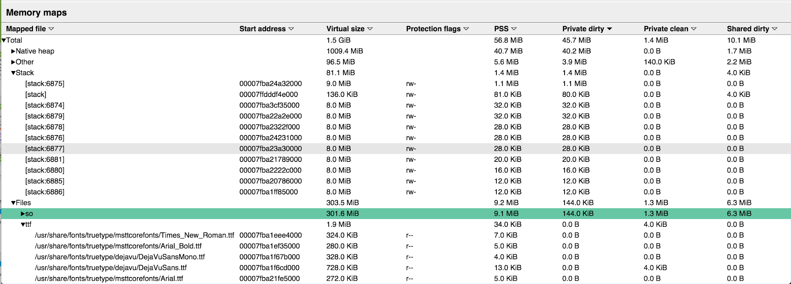
System Stats – Full Memory Maps (Linux/Android only)

Slide 29
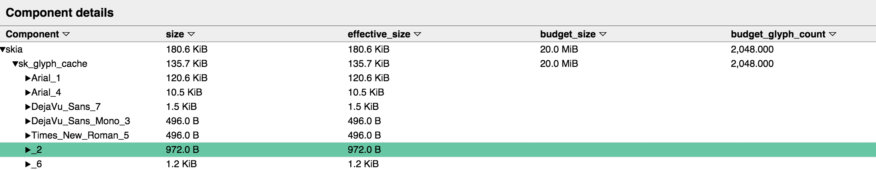
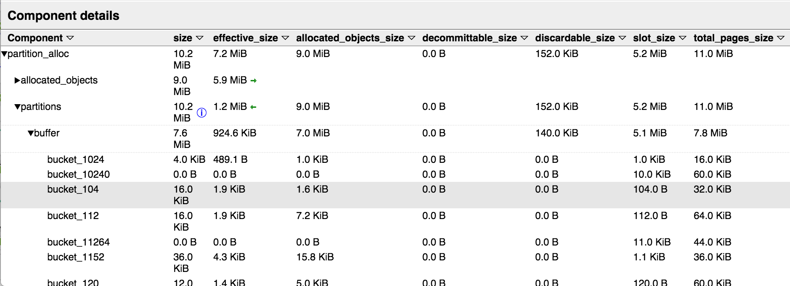
Chrome Subsystem Details

Slide 30
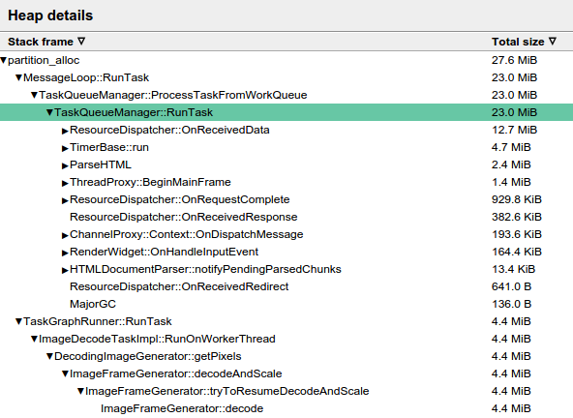
Heap Profiler
30.2 MiB
27.6
MiB
Get details about allocations in the heap
Where did the allocations happen?
Breakdown (pseudo)stack trace
What are the allocations used for?
Breakdown by object type (coming soon)
A combination of both (coming soon)
No special GYP / rebuild. Just start chrome with --enable-heap-profiling
Instructions: https://www.chromium.org/developers/how-tos/trace-event-profiling-tool/memory/heap-profiling-with-memory-infra

Slide 31
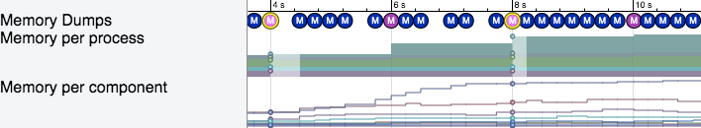
Diff Analysis
Select multiple dumps...

Slide 32
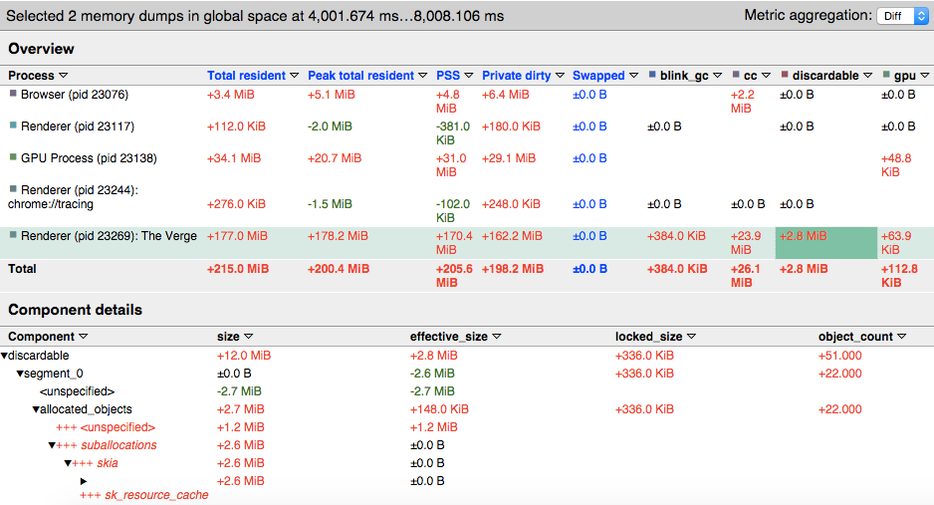
Diff Analysis

Slide 33

Startup Tracing
Capture memory traces at startup/shutdown
e.g., measure background sync memory usage
trace file
tracing_startup_config.json
{
"startup_duration": 4,
"result_file": "/tmp/trace.json",
"trace_config": {
"included_categories": ["disabled-by-default-memory-infra"],
"memory_dump_config": {
"triggers": [
{"mode":"light", "periodic_interval_ms": 50},
{
"mode":"detailed",
"periodic_interval_ms": 1000
} ...
--trace-config-file=\ tracing_startup_config.json
Instructions: https://www.chromium.org/developers/how-tos/trace-event-profiling-tool/memory/startup-tracing-with-memory-profiling
Notes:
Real use case: background sync / service workers w. push messages

Slide 34
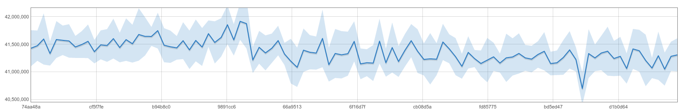
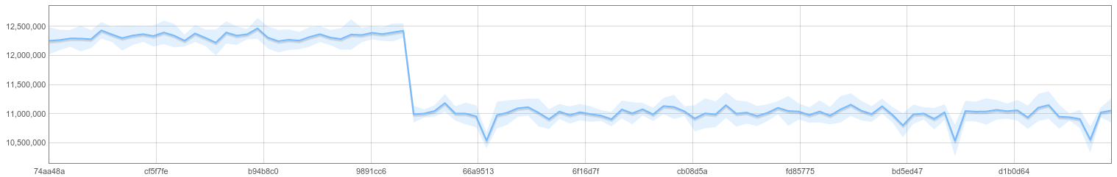
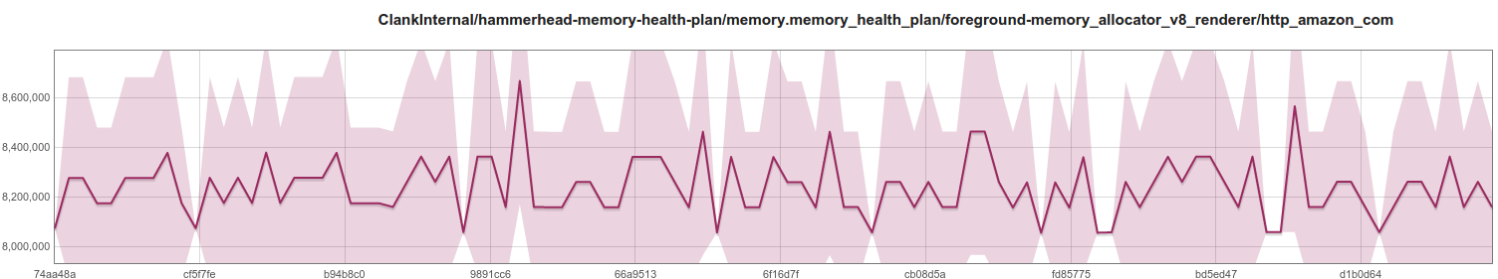
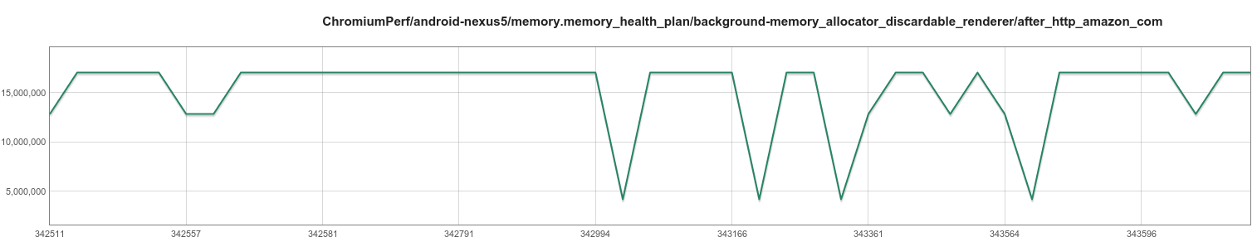
Telemetry Benchmarks
Until today we mostly tracked totals from the system – noisy, unactionable
private dirty total
Now we can keep track of individual components
malloc [link dashboard]
Σ
v8 [link dashboard]
discardable [link dashboard]
Notes:
Full slide deck for more context:
https://docs.google.com/presentation/d/1OyxyT1sfg50lA36A7ibZ7-bBRXI1kVlvCW0W9qAmM_0/edit#slide=id.gde150139b_0_137

Slide 35
The Plan
Telemetry
Switch existing benchmarks to memory infra (currently beta testing with memory.top_10_mobile and memory.blink_memory_mobile)
Get fine-grained alerts for individual memory metrics
Simpler UI for performance dashboard
Perf Insights
Get data from the field using deep reports
Integrate with PI mappers / RAIL++

Slide 36
Thanks
Questions?
References:
Wiki: bit.ly/memory-infra
Bugs: Hotlist=MemoryInfra (file via go/mibug)
Group: chromium.org/project-trim

